Slide 1
Title: PlacementBot - AI-Powered Career Assistant & Resume Analyzer
Subtitle: A MERN Stack Solution for Modern Placement Preparation
Key Points:
Objective: To bridge the gap between academic preparation and industry requirements.
Vision: Empowering students with instant AI-driven career guidance.
Goal: Automate resume analysis and placement query handling.

Slide 2
The Problem:
Students struggle with resume optimization for ATS (Applicant Tracking Systems).
Difficulty in finding instant, reliable answers to complex placement-related queries.
Lack of personalized roadmaps for skill improvement.
The Solution:
AI Chatbot: Integrated with Groq Cloud for real-time interview and career advice.
Resume Analyzer: Deep text parsing and AI-driven feedback for resume improvement.
Skill Tracking: Visual analytics to monitor progress and readiness.

Slide 3
Core Features Overview
Intelligent Chat Interface: Natural language interaction for all placement queries.
Resume Scoring & Feedback: Upload PDF/Docx to get an instant "Industry-Readiness" score.
Personalized Roadmaps: Dynamic learning paths generated based on resume gaps.
Student Analytics Dashboard: Recharts-powered visualization of resume performance.
Secure User Profiles: Role-based access and profile management.

Slide 4
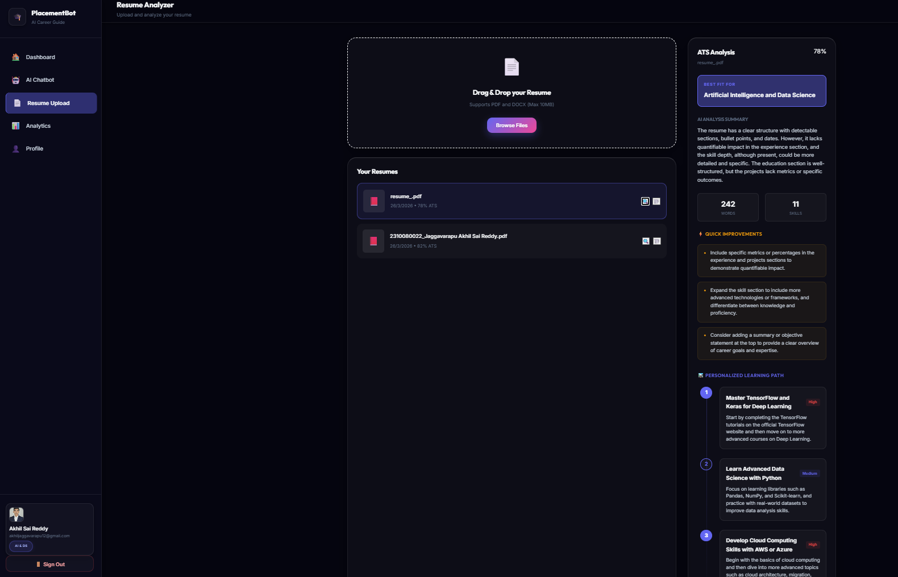

Slide 5
Technology Ecosystem (MERN + AI)
A Full-Stack Modern Web Architecture:
Frontend: React.js (v19), Vite, Tailwind CSS, Framer Motion, Recharts.
Backend: Node.js, Express.js, RESTful API structure.
Database: MongoDB Atlas with Mongoose ODM for scalable data modeling.
AI Engine: Groq Cloud LPU™ (Llama-3 & GPT-OSS models) for near-instant inference.
Tools: Multer (Uploads), PDF-Parse/Mammoth (Document Processing), JWT (Security).

Slide 6
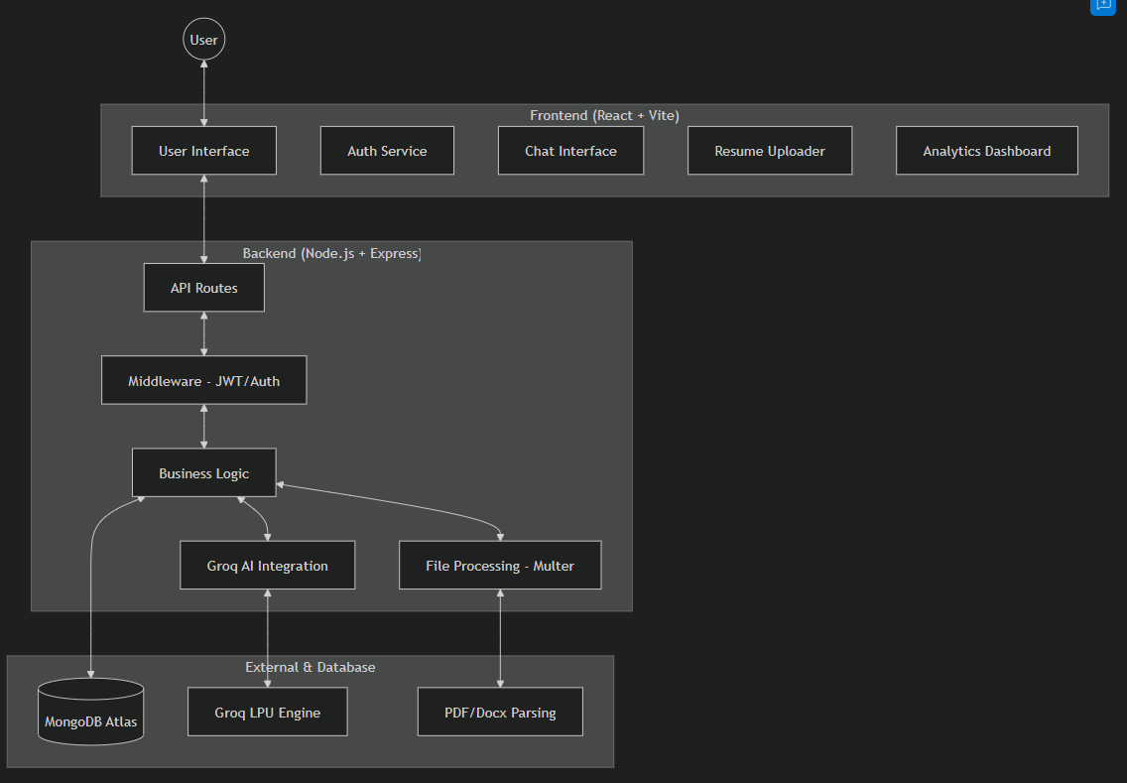
System Architecture

Slide 7
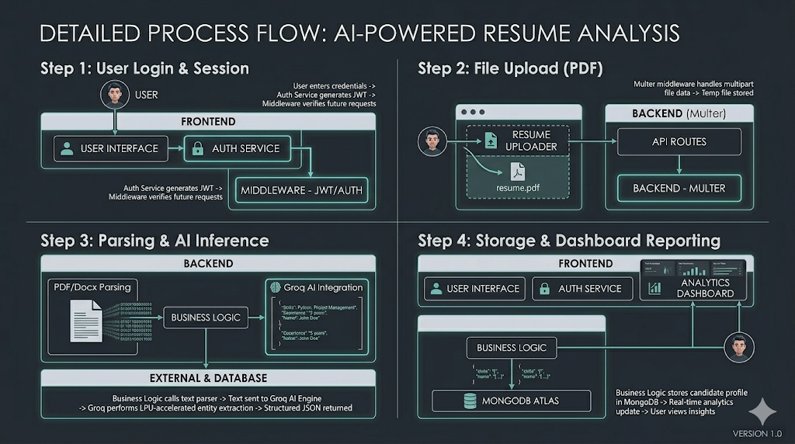


Slide 8
AI Intelligence: Classification & Regression
Core Data Science Concepts in PlacementBot:
Classification (Intent & Tiering):
Intent Classification: Categorizing 100% of user queries into 7 distinct buckets (e.g., career paths vs. resume tips).
Tier Classification: Multi-class categorization of resumes into 5 distinct levels (Incomplete to Elite).
Skill Mapping: Classifying extracted text into specific "Technical" vs. "Soft" skill labels.
Regression-Like Tasks (ATS Scoring):
ATS Score Prediction: Predicting a continuous numerical score (0-100) based on weighted features (Impact, Structure, Depth).
Trend Analysis: Calculating average performance shifts and predicting readiness based on score history.
Logic Basis: 100-point rubric for objective, consistent evaluation.

Slide 9
Resume Analysis Workflow
The "Brain" Behind PlacementBot:
Upload: User provides a resume file (PDF/Docx).
Extraction: Backend uses pdf-parse or mammoth to extract raw text content.
Analysis: Extracted text is sent to the Groq AI model with a specialized context-aware prompt.
Scoring: AI evaluates content based on the industry-standard scoring rubric.
Guideline: AI generates a specific "Improvement Roadmap" with high-priority learning steps.

Slide 10
Database Design (Mongoose)
Data Persistence & Modeling:
User Schema: Manages credentials, roles (Student/Admin), and profile metadata.
Chat History Schema: Maintains persistent message logs for context-aware AI interactions.
Resume Analytics Schema: Stores historical scores, extracted skills, and personalized feedback.
Security: Bcrypt password hashing and JWT-based session management.

Slide 11
Project Impact & Future Scope
Current Impact:
Instant career coaching (24/7 availability).
Data-driven resume optimization for better ATS passing rates.
Personalized learning paths to bridge the industry-academic gap.
Future Scope:
AI Mock Interviews: Real-time voice/video simulation.
Job Aggregator: Automatic matching of analyzed resumes with live job postings.
Community Portal: Peer-to-peer discussion and interview experience sharing.

